Slide 1
Introduction to Spring
And its use in OpenMRS

Slide 2
A framework?
A software framework provides a structure for an application
Makes it easier to integrate with other technologies
We add code to customize the framework for our specific application
A framework runs our code, rather than our code running it, i.e. the Hollywood Principle: "Don't call us, we'll call you"

Slide 3
Library vs Framework
Application
Application
Class
Class
Class
Framework
Class
Class
Class
Library
Class
Class
Class
Class
Class
Class
Application maintains control
and calls library class methods
as it needs
Application registers its classes
with the framework and then
gives it control
This called inversion of control

Slide 4

What is Spring?
It's Open-source (Apache License)
Written for .NET as well as Java
First release in 2003
Alternative to the Jakarta Struts framework
Substitute for Enterprise Java Beans
Designed to be modular - you only have to use the parts you need
Designed to be easy to test

Slide 5
Spring features
These are the main features of Spring being used by OpenMRS:
Inversion of control container
Aspect-oriented programming
Data-access framework
Model-view-controller framework
Internationalization

Slide 6
Inversion of control container
Responsible for
Creating objects (loads XML bean definitions)
Calling initialization methods
Configuring objects by wiring them together
<beans>
<bean class="Foo">
...
</bean>
<bean class="Bar"></bean>
...
</beans>
IoC Container
Foo
Bean
Bar
Bean
Bean
#3
This XML is called the application context

Slide 7
Bean definitions
Spring uses XML definitions to create beans, e.g.
Java class
with bean
properties
public class Person {
...
public String getSurname() { ... }
public void setSurname(String surname) { ... }
public int getAge() { ... }
public void setAge(int age) { ... }
}
XML file
with bean
definitions
<beans>
<bean id="admin" class="Person">
<property name="surname" value="Seymour" />
<property name="age" value="28" />
</bean>
</beans>
Equivalent
to...
Person admin = new Person();
admin.setSurname("Seymour");
admin.setAge(28);

Slide 8
Dependencies
Spring extracts dependencies into one location - the XML application context
Supposing we have an typical application with several components...
DAO
(Hibernate)
DB
(MySQL)
Views
(JSP)
Servlets
(Java)

Slide 9
Dependencies
Specifying JSP paths inside servlets creates a dependency between those two components, i.e. we can't change one without changing the other...
DAO
(Hibernate)
DB
(MySQL)
Views
(JSP)
Servlets
(Java)

Slide 10
Dependencies
Putting DAO code into a servlet or JSP creates more dependencies...
DAO
(Hibernate)
DB
(MySQL)
Views
(JSP)
Servlets
(Java)

Slide 11
Dependencies
Putting MySQL specific connection code into the DAO, using SQL in the servlet...
DAO
(Hibernate)
DB
(MySQL)
Views
(JSP)
Servlets
(Java)

Slide 12
Dependencies
Spring attempts to keep dependencies in one place - the application context - it connects all the different components as beans...
DAO
(Hibernate)
DB
(MySQL)
App.
Context
Views
(JSP)
Servlets
(Java)

Slide 13
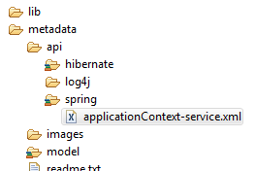
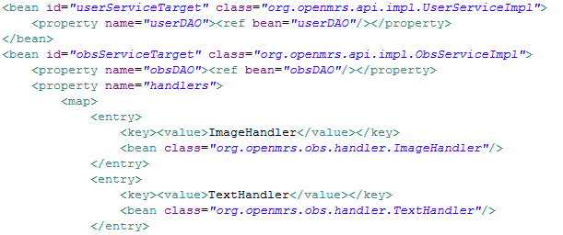
In OpenMRS...
Beans are defined in an XML file

Slide 14
Aspect-oriented programming
A typical application is made up of different concerns - areas of functionality, e.g. logging, authorization, data access
Often these end up mixed in the same methods, e.g.
public List<Patient> getAllPatients() {
log.debug("Getting all patients");
if (User.hasPrivilege("View Patients"))
return null;
return db.getAllPatients();
}
Logging concern
Authorization concern

Slide 15
Aspect-oriented programming
Spring's AOP support allows us to configure code to be executed before or after multiple methods, e.g.
It's possible that many methods will start with an authorization check
We can define an annotation and tell Spring to execute a specific method when it encounters that annotation
@Authorized("View Patients")
public List<Patient> getAllPatients() {
log.debug("Getting all patients");
return db.getAllPatients();
}

Slide 16
Aspect-oriented programming
getAllPatients() {
...
}
class Authorize {
authorization
checking code
}
getUser() {
...
}
authorization checking code
authorization checking code
getDrugById() {
...
}
getPatientObs() {
...
}
authorization checking code
Without AOP, code for
different concerns is
mixed
authorization checking code

Slide 17
Aspect-oriented programming
@Authorize("...")
getAllPatients() {
...
}
class Authorize {
authorization
checking code
}
@Authorize("...")
getUser() {
...
}
@Authorize("...")
getDrugById() {
...
}
@Authorize("...")
getPatientObs() {
...
}
With AOP, code for
different concerns is
kept separate
@Authorize("...") is called a join point

Slide 18
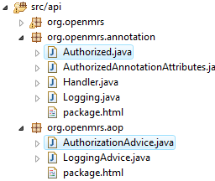
In OpenMRS...
Join points are set using annotations
Advice is concern specific code to be executed at join points
For example:
Authorized annotation executes a method in AuthorizationAdvice

Slide 19
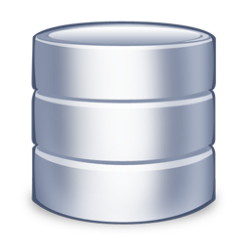
Data-access framework
Spring is designed to work with many different database frameworks, e.g.
Hibernate
JDBC
JDO
Oracle Toplink
For each of these Spring offers
Resource management
Transaction management
Exception translation

Slide 20
Data-access framework
Resource management means that Spring can acquire and release the data framework objects for us
Data connection is configured as a bean, e.g.
<bean id="myDataSource" class="org.apache.commons.dbcp.BasicDataSource">
<property name="driverClassName" value="org.gjt.mm.mysql.Driver" />
<property name="url" value="jdbc:mysql://localhost/" />
<property name="defaultCatalog" value="intranet" />
<property name="username" value="admin" />
<property name="password" value="test" />
</bean>

Slide 21
Data-access framework
Even the different data frameworks can be configured in a consistent way, as beans, e.g.
<bean id="sessionFactory" class="org.springframework.orm.hibernate3.LocalSessionFactoryBean">
<property name="dataSource" ref="myDataSource"/>
<property name="mappingResources">
<list>
<value>ehsdi/intranet/api/db/hibernate/User.hbm.xml</value>
<value>ehsdi/intranet/api/db/hibernate/Role.hbm.xml</value>
<value>ehsdi/intranet/api/db/hibernate/Privilege.hbm.xml</value>
<value>ehsdi/intranet/api/db/hibernate/Patient.hbm.xml</value>
</list>
</property>
<property name="hibernateProperties">
<value>
hibernate.dialect=org.hibernate.dialect.MySQL5Dialect
hibernate.show_sql=false
</value>
</property>
</bean>

Slide 22
Data-access framework
Transaction management means that transactions can be wrapped around method calls automatically
For example, using Hibernate without Spring's transaction management, we must explicitly create transactions:
private List<Person> getAllPersons() {
Session session = HibernateUtil.getSessionFactory().getCurrentSession();
session.beginTransaction();
List<Person> persons = session.createCriteria(Person.class).list();
session.getTransaction().commit();
return persons;
}

Slide 23
Data-access framework
Using Spring's annotation driven transaction management, we can have all the methods of a class, wrapped in transactions
@Transactional
class PatientService {
...
private List<Person> getAllPersons() {
List<Person> persons =
session.createCriteria(Person.class).list();
return persons;
}
...
}

Slide 24
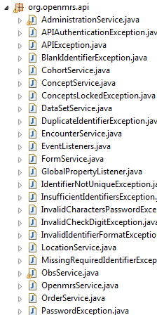
In OpenMRS...
OpenMRS has a service layer
Contains classes which interact with the data access layer (Hibernate)
All of the service classes implement an equivalent interface in org.openmrs.api
These service interfaces use the @Transactional annotation

Slide 25
In OpenMRS...
Layer
Package / JAR
Example
Services
org.openmrs.api
PatientService
org.openmrs.api.impl
PatientServiceImpl
DAO
org.openmrs.db
PatientDAO
org.openmrs.db.hibernate
HibernatePatientDAO
Hibernate
hibernateXX.jar
JDBC
java.sql
MySQL
mysql-connector-java-XX.jar

Slide 26
Model-view-controller framework
Enforces separation of the three components
Defines a set of interfaces to be implemented
Not limited to JSP based views
Controllers are configured as beans like everything else, and have access to other beans
A controller is not a servlet!

Slide 27
Front controller / URL Mapping
Spring uses a front controller model
All requests have a single entry point
Front controller
Controllers
Client
Dispatcher
Servlet
Controller
#1
Controller
#2
Url
Mapping
Controller
#3
<bean id="urlMapping" class="org.springframework...SimpleUrlHandlerMapping">
<property name="mappings">
<props>
<prop key="admin/patients/patient.form">patientForm</prop>
<prop key="admin/patients/newPatient.form">newPatientForm</prop>
<prop key="admin/patients/mergePatients.form">mergePatientsForm</prop>
...
</props>
</property>
</bean>
URLs
Controllers

Slide 28
Spring MVC workflow
Handles
request
Sends
request
Delegates
request
Client
Dispatcher
Servlet
Controller
model
Returns
response
Creates
model
model
Return
control
View Template (i.e. a JSP)
Render
response

Slide 29

The Controller interface
A controller should handle a request by returning a model and a view
Thus the controller interface is very simple:
public interface Controller {
public ModelAndView handleRequest(
HttpServletRequest request,
HttpServletResponse response
) throws Exception;
}

Slide 30

The View interface
A view should render a response, given a model
Thus the view interface is also very simple:
public interface View {
public void render(
Map model,
HttpServletRequest request,
HttpServletResponse response
) throws Exception
}

Slide 31
Models
Models in Spring MVC are usually maps, e.g.
Map entries automatically become request attributes, accessible in a JSP, e.g.
Map model = new HashMap();
model.put("patient", patient);
model.put("encounter", encounter);
${patient.surname}
${encounter.location}

Slide 32
ModelAndView
This is used to pass the model between the controller and the view
It is constructed by specifying a view and a model
View can be specified by name, which is then resolved to a JSP by the dispatcher servlet
Map model = new HashMap();
model.put("patients", patients);
return new ModelAndView("patientList", model);

Slide 33
Example: Spring MVC
IoC Container
Client
GET /index.htm
Dispatcher
Servlet
/index.htm
UrlMapping
<html>...</html>
HelloController
.handleRequest()
HelloController
<html>...</html>
model
/WEB-INF
model + view name: hello
index.jsp
hello.jsp
ViewResolver
view name: hello
/WEB-INF/hello.jsp

Slide 34
Controller classes
It's unusual to implement Controller directly - usually we extend of one Spring's predefined controller classes, which offer extra functionality, e.g.
AbstractController
Generates cache headers
Can be configured to accept/refuse GET or POST
ParameterizableViewController
View name can be configured as bean property

Slide 35
Controller classes
When using one of these classes, override handleRequestInternal instead of handleRequest
class AbstractController implements Controller {
...
public ModelAndView handleRequest() {
// Sets up cache headers etc
...
return handleRequestInternal();
}
protected abstract ModelAndView handleRequestInternal();
}
Predefined
spring
controller
class
Our
custom
controller
class HelloController extends AbstractController {
protected ModelAndView handleRequestInternal() {
return new ModelAndView("hello");
}
}

Slide 36
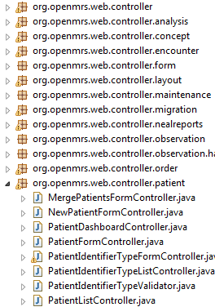
In OpenMRS...
Controller classes are in subpackages of org.openmrs.web.controller
These are instantiated as beans in WEB-INF/openmrs-servlet.xml
This file also defines a URL mapping bean, which maps URLs to controllers

Slide 37
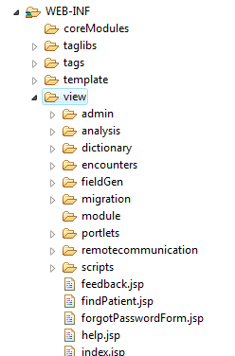
In OpenMRS...
Views are JSP files, stored in web/WEB-INF/view

Slide 38
References
Websites
http://www.springsource.org/
http://en.wikipedia.org/wiki/Spring_Framework
http://www.theserverside.com/tt/articles/article.tss?l=SpringFramework

